Slide 1
CSC4200/5200 – COMPUTER NETWORKING
Welcome and Introduction
Instructor: Susmit Shannigrahi
sshannigrahi@tntech.edu

Slide 2
Welcome
Class website: https://tntech-ngin.github.io/F24-CSC4200/
Syllabus
Grading policies
Homework and assignments
Instructor: Susmit Shannigrahi
Office hours: Monday, Tuesday 10-11AM
Email : sshannigrahi@tntech.edu
GTA: Xi Wang
Office hours –9-10AM Tuesday, 3:15-4:15 Thursday
Email: xwang45@tntech.edu

Slide 3
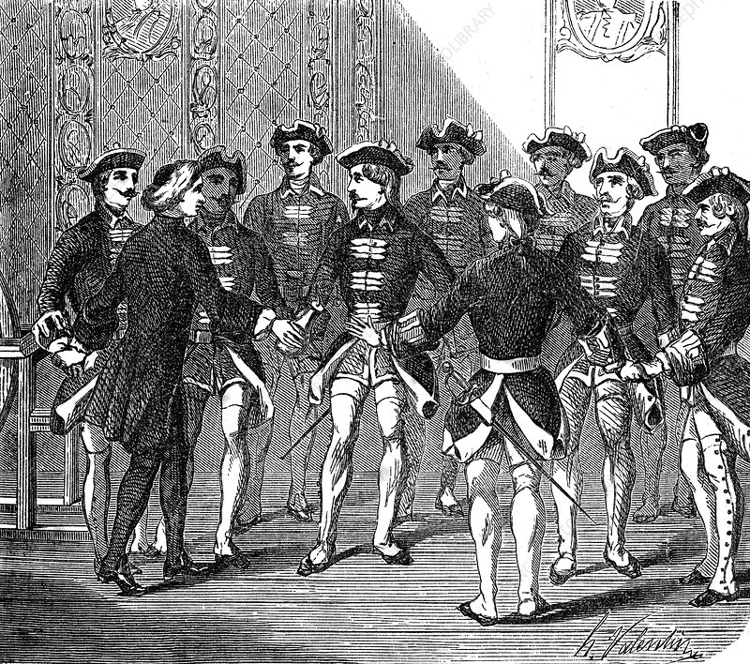
The Mother of All Networks
Science Photo Library
Notes:
1746 – Nollet - Get this image on: Science Photo Library

Slide 4
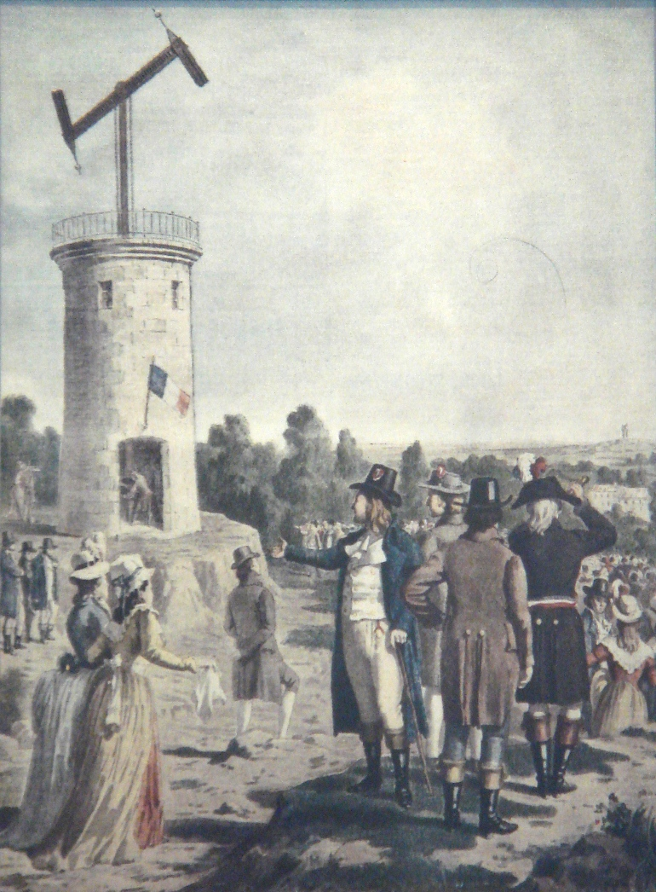
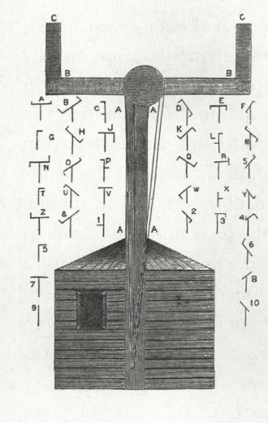
The Optical Telegraph

Slide 5
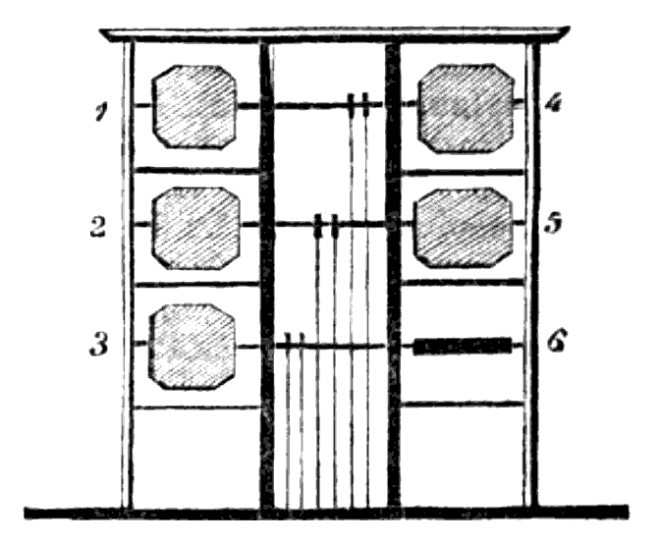
The Optical Telegraph

Slide 6
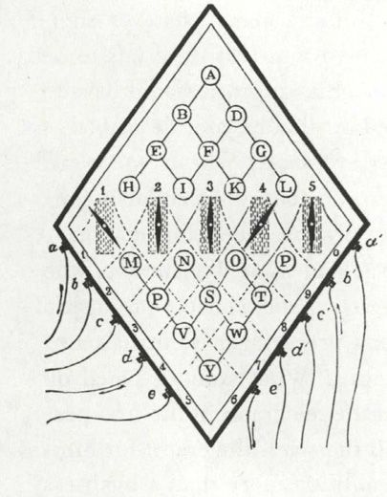
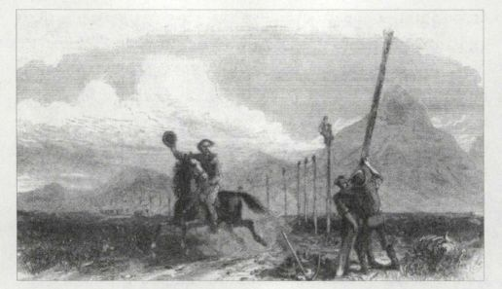
The Electric Telegraph

Slide 7
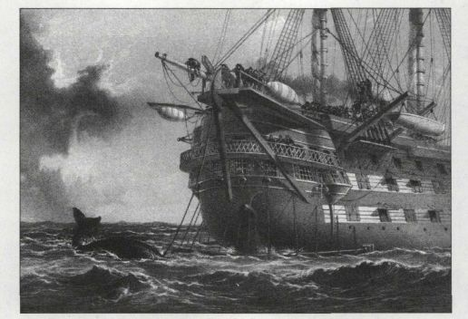
Connecting the World
HMS Agamemnon encounters a whale during the laying of the first transatlantic cable, July 1858.

Slide 8
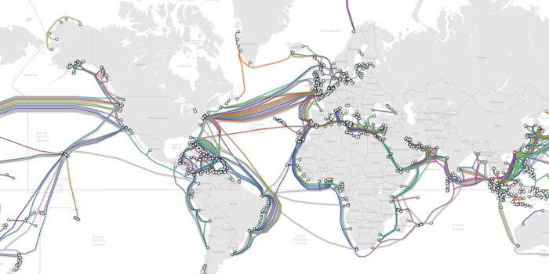
Transoceanic Cables Today

Slide 9
Hackers and Gamers
YOUR LUGGAGE AND TARTAN WILL BE SAFE BY THE NEXT TRAIN.

Slide 10
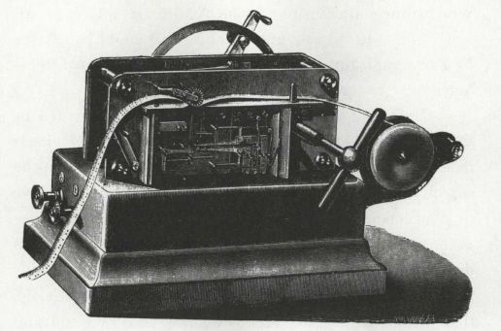
Wheatstone Automatic transmitter
Messages were prepunched on a paper tape and then transmitted in Morse code at very high speed as the tape was fed through the machine.

Slide 11
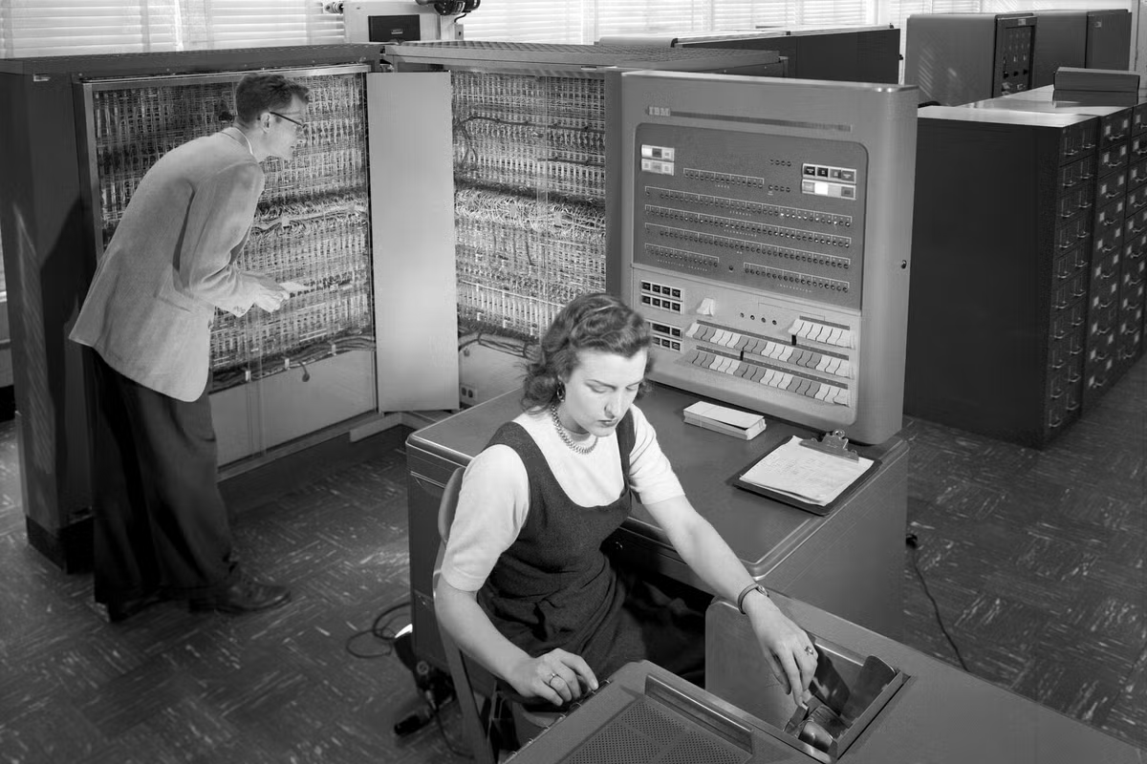
Punch Card Computers
Punched card computers

Slide 12
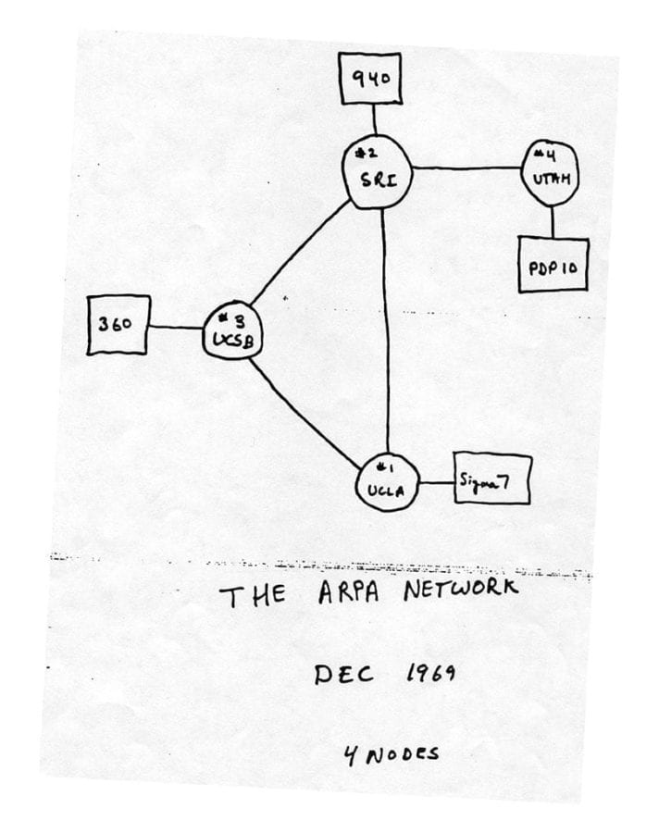
The ARPA Network

Slide 13
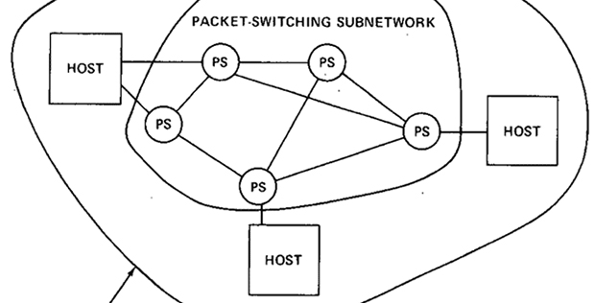
Packet Switching

Slide 14
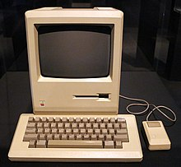
Personal Computers

Slide 15
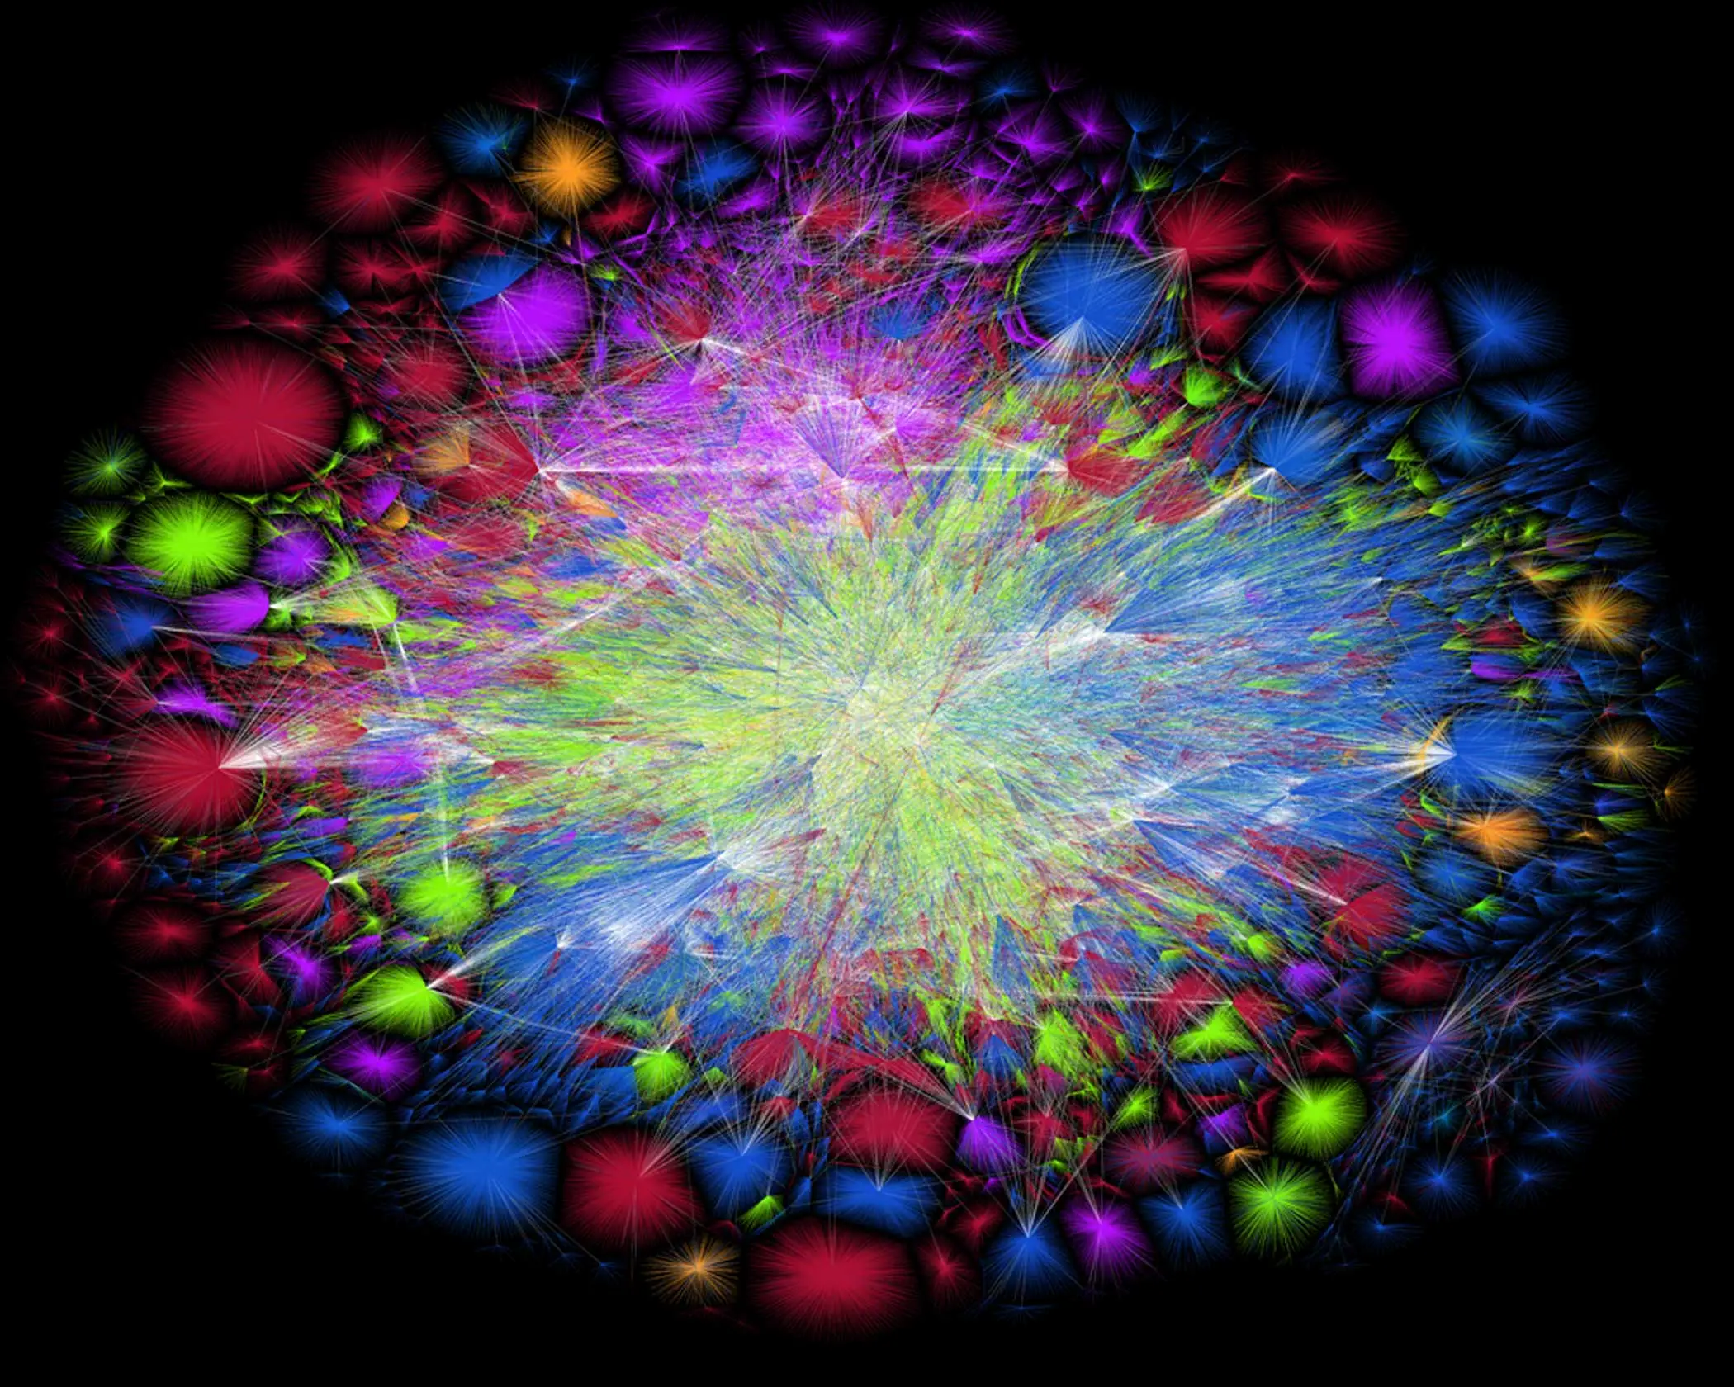
Current Internet

Slide 16
Current Internet’s Evolution
https://www.youtube.com/watch?v=DdaElt6oP6w

Slide 17
Social Contract
https://tinyurl.com/csc4200-mural
Notes:
Ndn can help organizing the namespaces
Once that’s done, data discovery and provenance is
Straight forward
Retrieval, transparent failover, and specialized operations
In this work, we take a real access log and try to quantify NDN’s improvements to a climate
workflow

Slide 18
Grading
Class exams on each broad area – 20%
Every 2 weeks or so (~5 exams)
Projects + Demo – 35%
Approximately 5 projects with increasing difficulty
You will set up meetings with the TA to go over your code
3 exams – 35%
approximately once every month (September, October, November) – 35%
No Midterm/ Final
Class participation – 10%
Participate in breakout sessions and discussions.
Class is not easy – you will not do well if you don’t participate.
Notes:
Ndn can help organizing the namespaces
Once that’s done, data discovery and provenance is
Straight forward
Retrieval, transparent failover, and specialized operations
In this work, we take a real access log and try to quantify NDN’s improvements to a climate
workflow

Slide 19
CSC5200
Extra reading and writing assignments
Notes:
Ndn can help organizing the namespaces
Once that’s done, data discovery and provenance is
Straight forward
Retrieval, transparent failover, and specialized operations
In this work, we take a real access log and try to quantify NDN’s improvements to a climate
workflow

Slide 20
Expectations from You
Be communicative – if you need help, please ask
Get started on the assignments sooner – they will take time
This class is not easy!
Especially you haven’t learned the background material so far
Need to work outside class hours
For every hour of lecture, you need to spend about 2 hours to study
Each lecture will have reading material
Notes:
Ndn can help organizing the namespaces
Once that’s done, data discovery and provenance is
Straight forward
Retrieval, transparent failover, and specialized operations
In this work, we take a real access log and try to quantify NDN’s improvements to a climate
workflow

Slide 21
Policies etc.
See below.

Slide 22
Policies
ChatGPT/CoPilot
You may use it but must disclose it.
Need to be able to explain your code/algorithm/protocol
One late submission allowed (programming assignment), no questions asked. Homeworks are due on time.
Use it wisely
Max 7 days late
Submit to iLearn
Other late submissions
Flat 50% deducted
No make-up exams.
Your responsibility to find conflicts and work with the instructor to resolve them
No cheating or plagiarism – Coding and/exams
You will fail the class
Notes:
Ndn can help organizing the namespaces
Once that’s done, data discovery and provenance is
Straight forward
Retrieval, transparent failover, and specialized operations
In this work, we take a real access log and try to quantify NDN’s improvements to a climate
workflow

Slide 23
Exams
3 exams.
Open book
Will be challenging
Memorizing will not help, you need to understand the topics
Notes:
Ndn can help organizing the namespaces
Once that’s done, data discovery and provenance is
Straight forward
Retrieval, transparent failover, and specialized operations
In this work, we take a real access log and try to quantify NDN’s improvements to a climate
workflow

Slide 24
Programming Assignments
Need to run on Google Cloud VMs – Ubuntu-20.10 or newer
Individual/Group assignments
We will learn how to break complex problems into smaller ones and divide tasks
C/C++/Python
If you want to use other languages, that’s okay
Talk to the GTA/Instructor first
Notes:
Ndn can help organizing the namespaces
Once that’s done, data discovery and provenance is
Straight forward
Retrieval, transparent failover, and specialized operations
In this work, we take a real access log and try to quantify NDN’s improvements to a climate
workflow

Slide 25
Logistics
Slides and recordings will be posted on the class website in the evening
Use the Teams channel to discuss, reach me or the TA
Notes:
Ndn can help organizing the namespaces
Once that’s done, data discovery and provenance is
Straight forward
Retrieval, transparent failover, and specialized operations
In this work, we take a real access log and try to quantify NDN’s improvements to a climate
workflow

